Slide 1
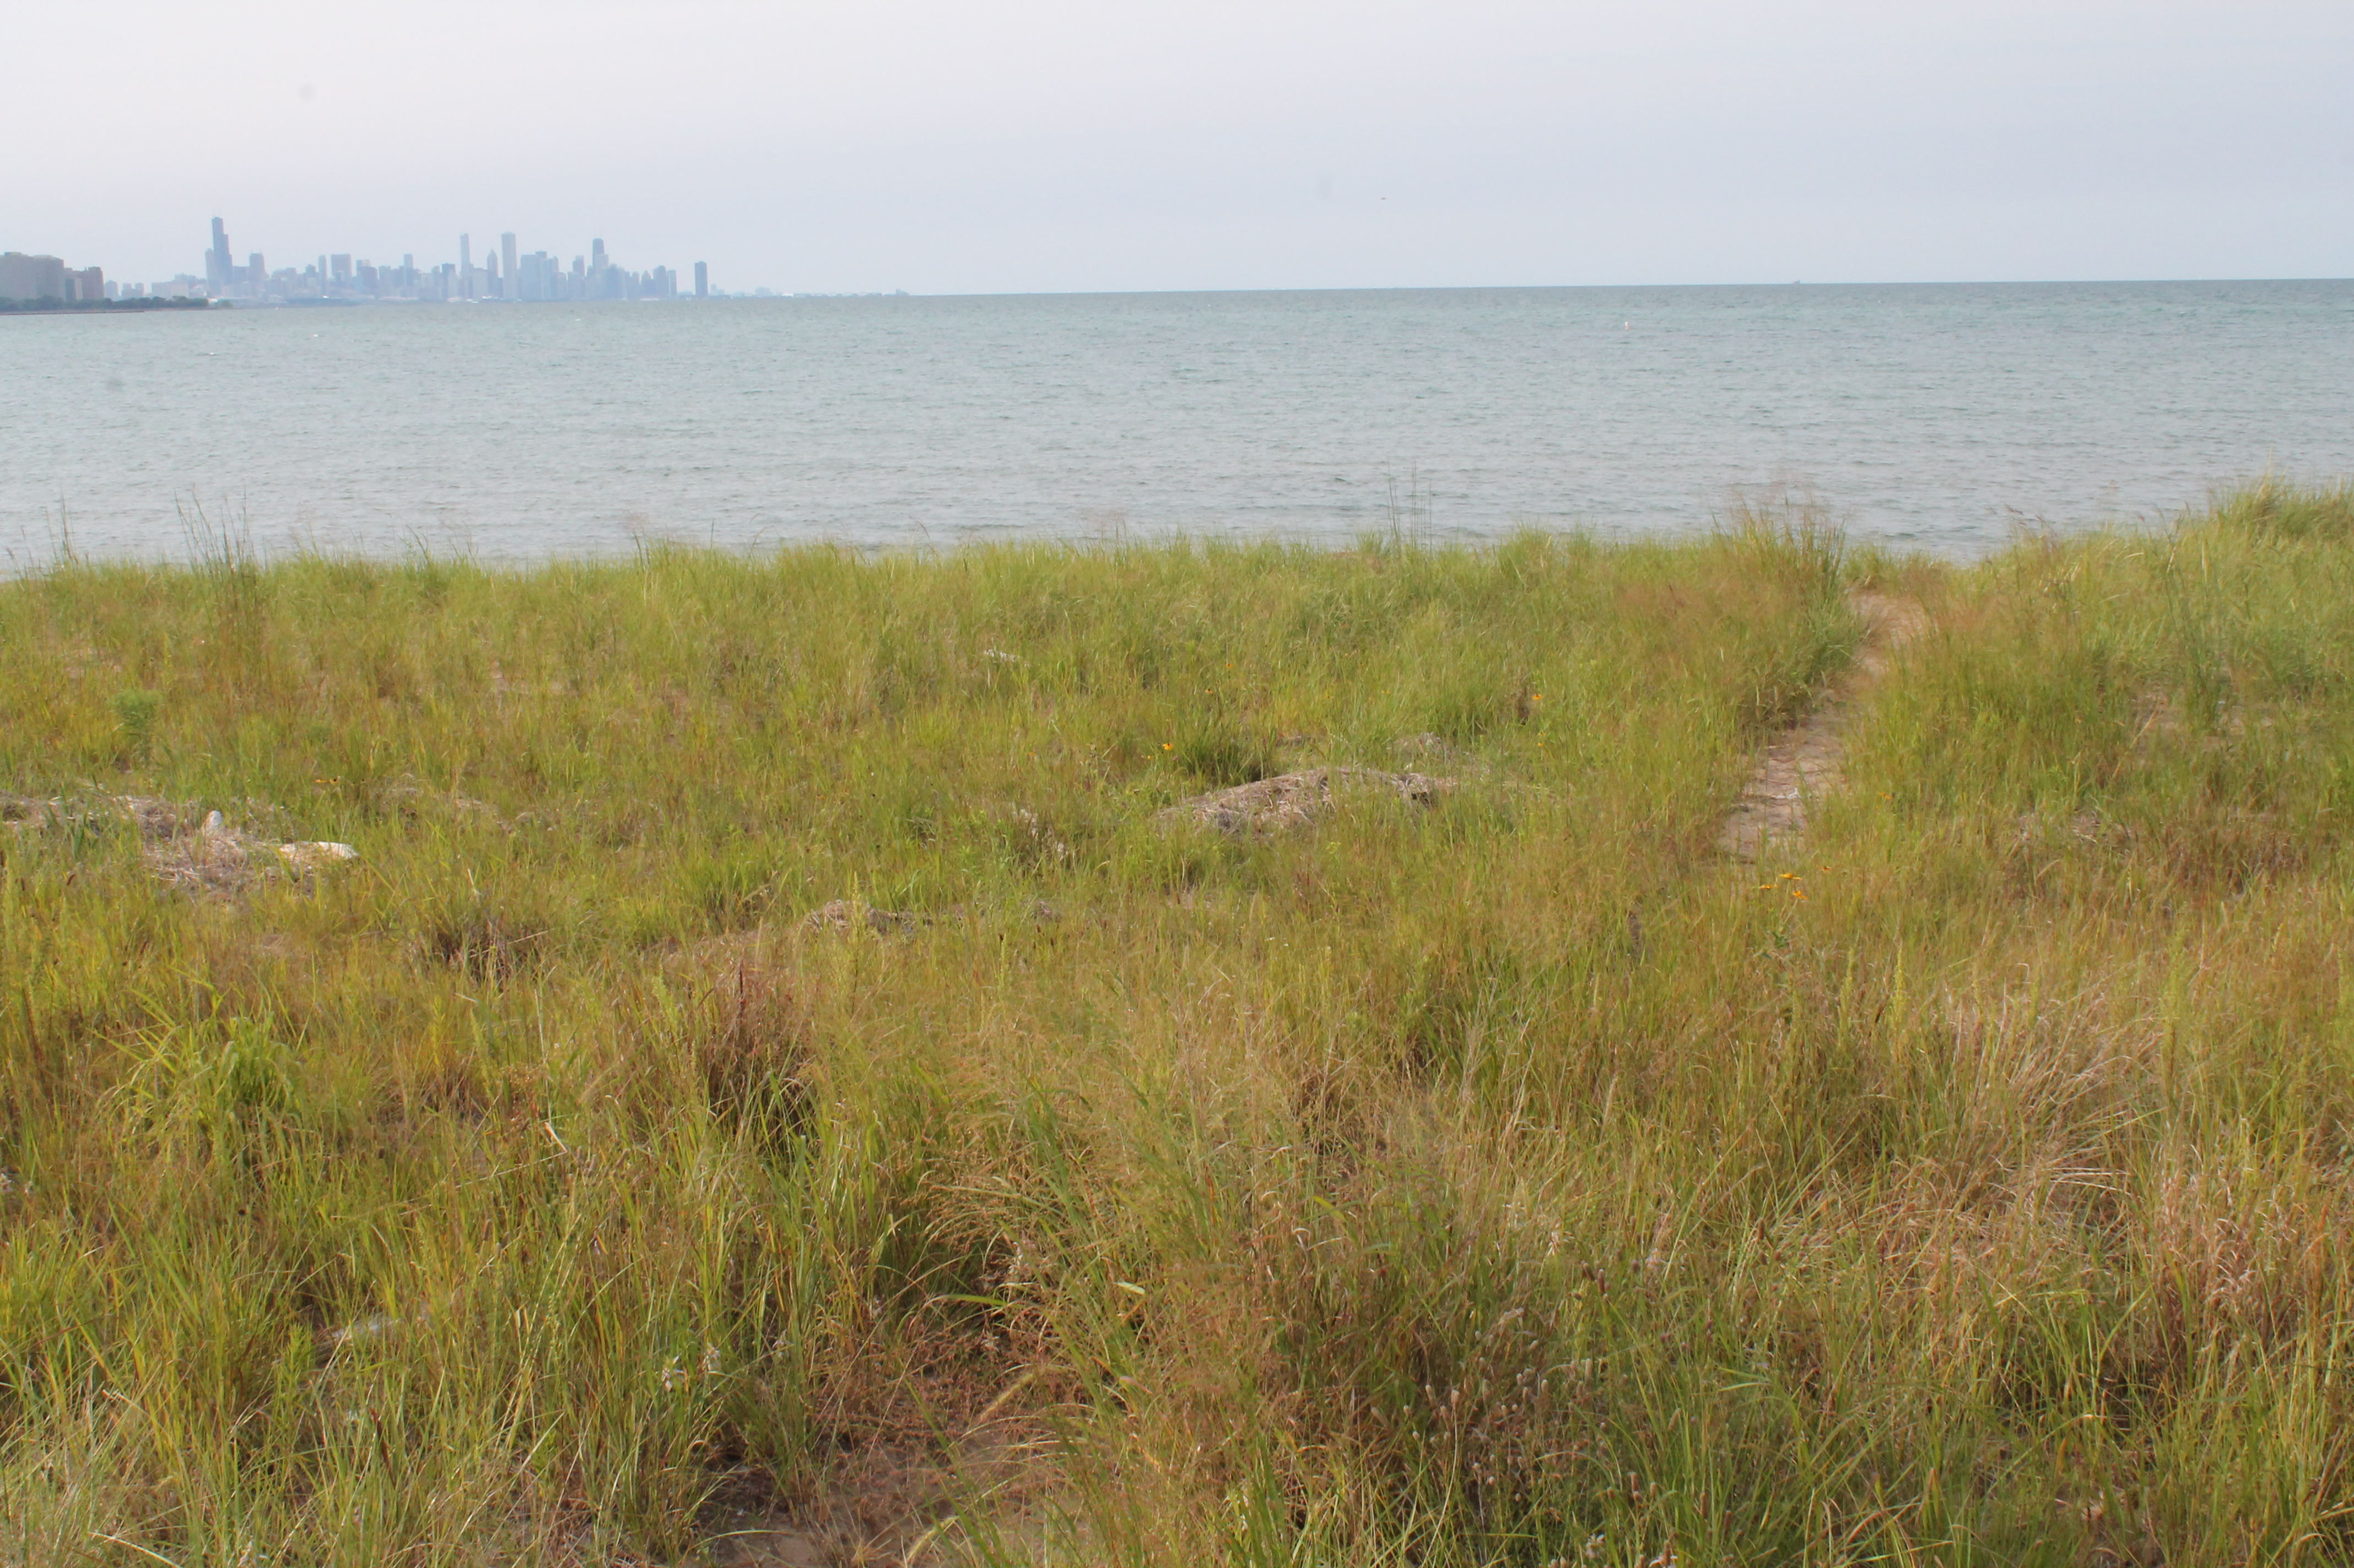
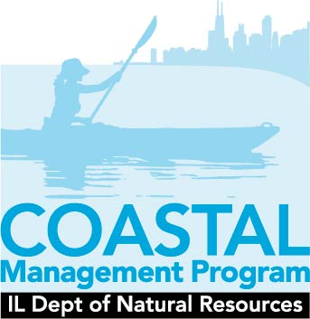
Lake Michigan and Coastal Campaign
Illinois Wildlife Action Plan
Lisa A. Cotner
IL DNR Coastal Management Program

Slide 2
Illinois Wildlife Action Plan
Goals
Assess the health of Illinois’ wildlife and habitats
Identify problems
Outline strategies and actions
Campaigns
Updated: Green Cities, Wetlands, Forests and Woodlands, Farmland and Prairie, Streams, Invasive Species
New: Lake Michigan and Coastal Campaign

Slide 3
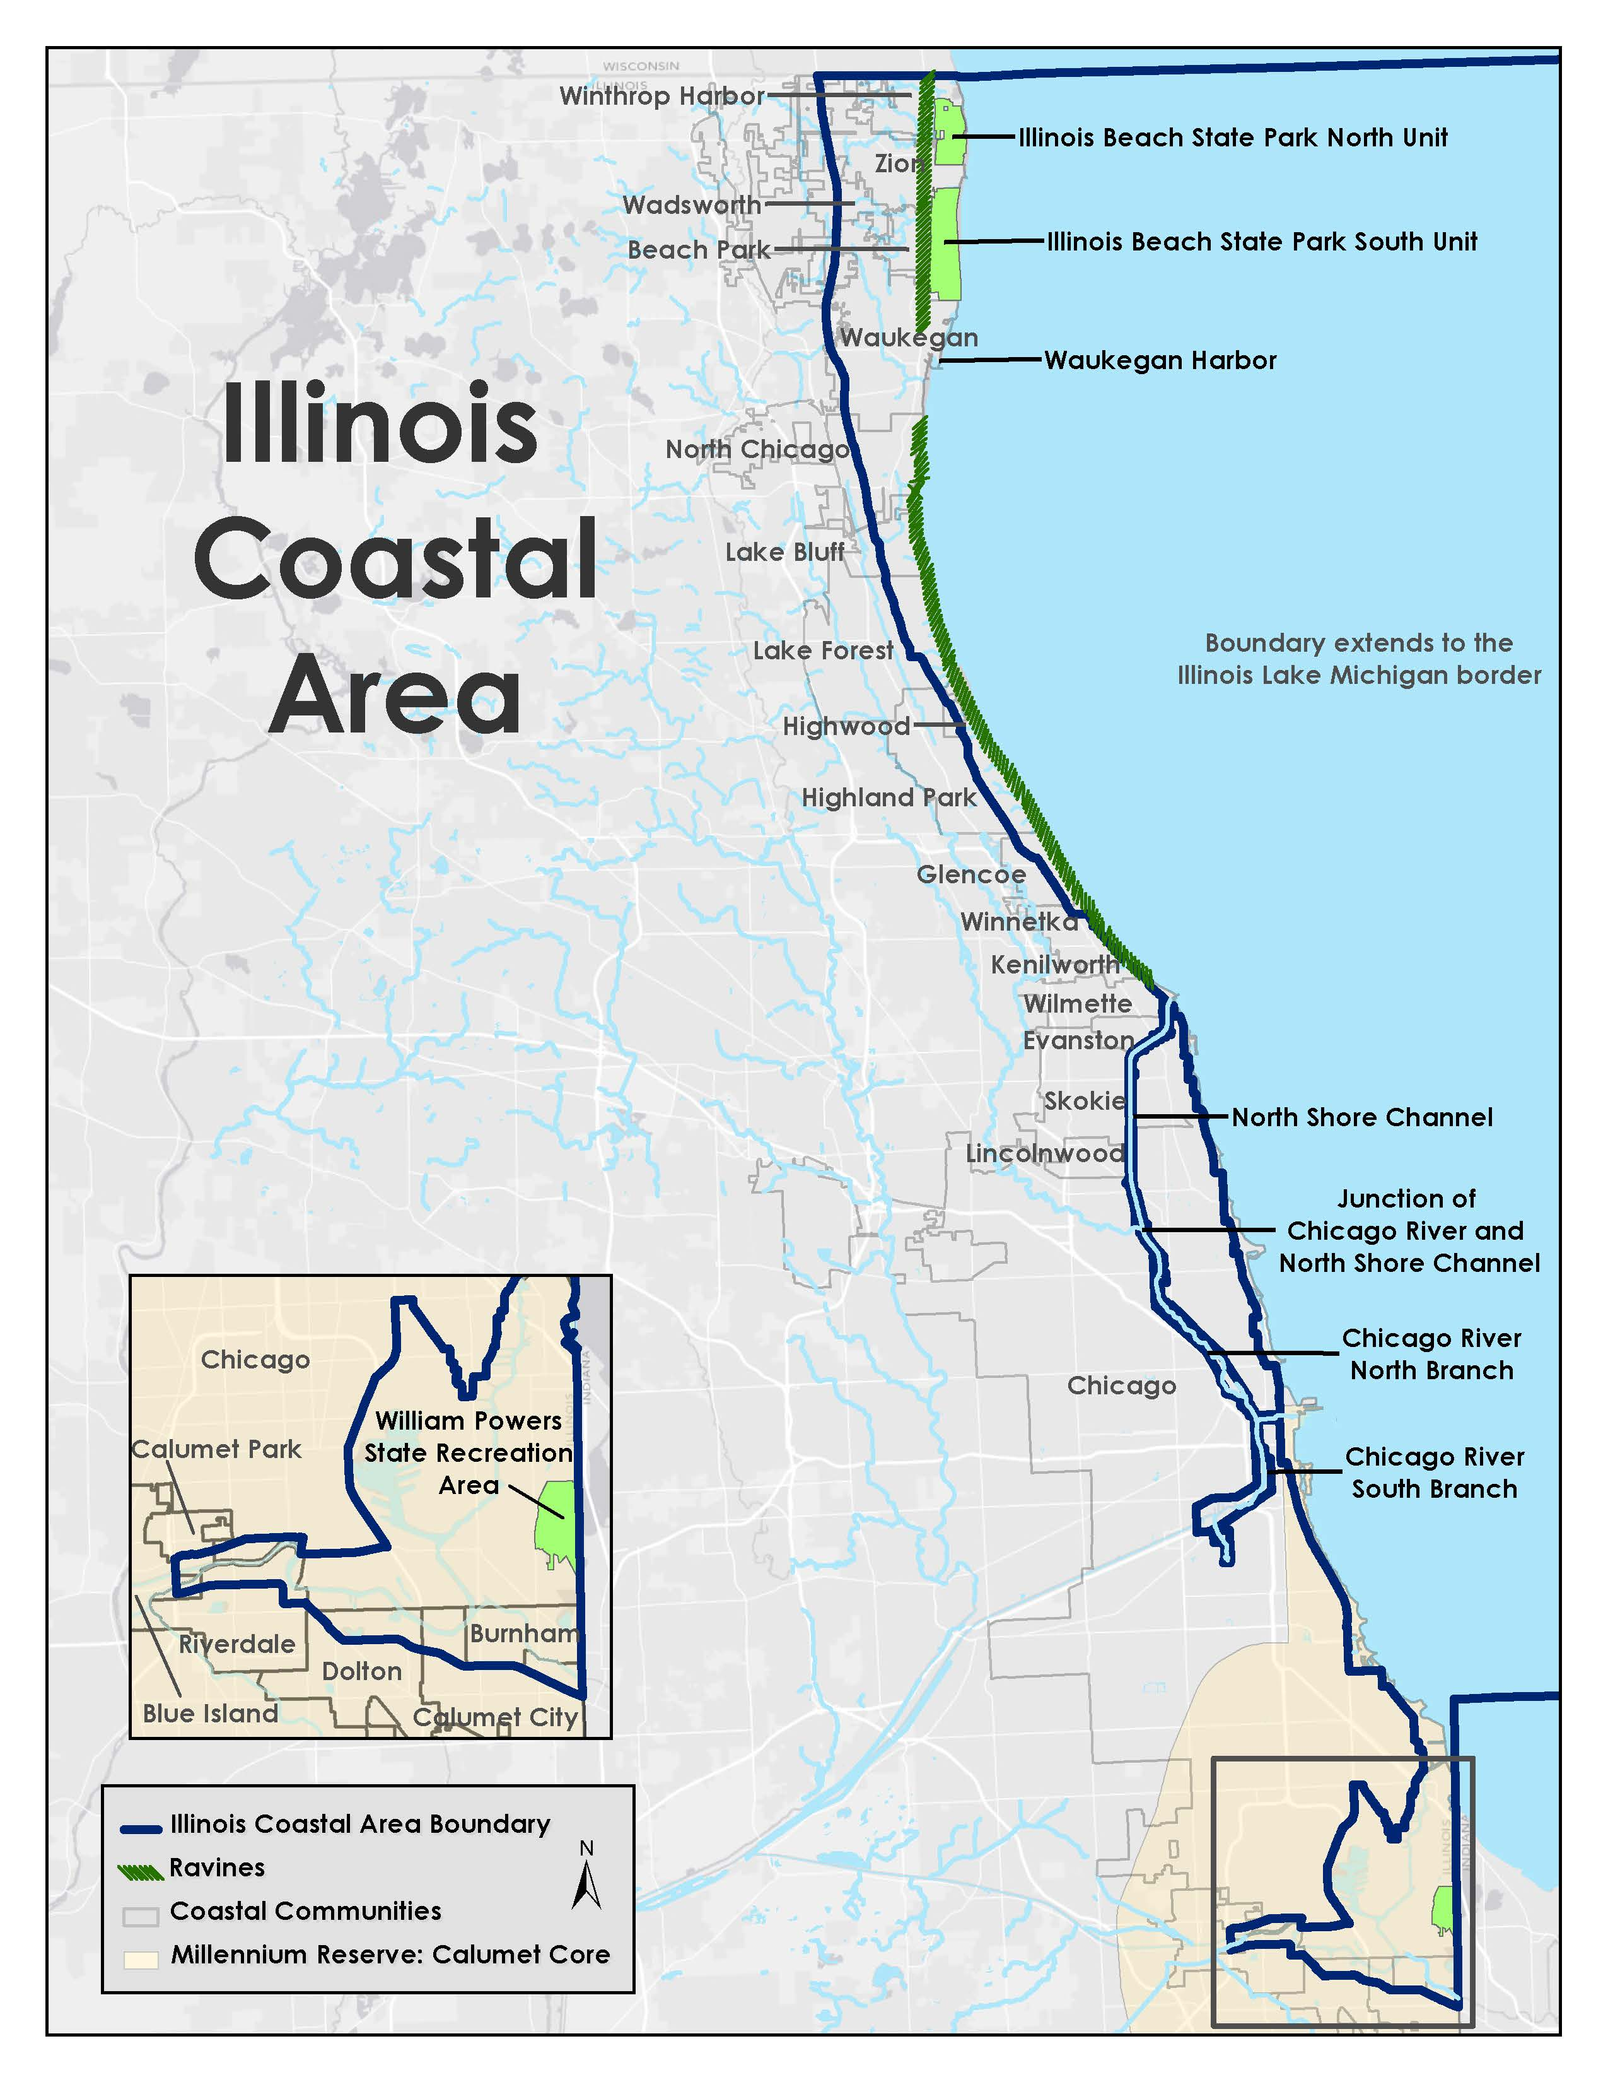

Slide 4
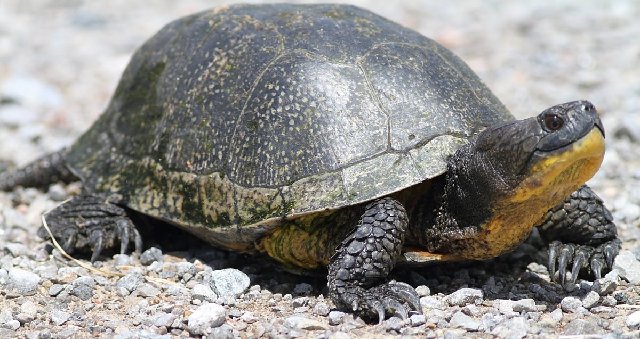
Coastal Campaign Goals
Minimize adverse effects of coastal development
Prevent and manage invasive species
Increase abundance and richness of native taxa
Protect and enhance rare coastal natural communities
Improve habitat connectivity
Enhance public support for fish and wildlife conservation

Slide 5
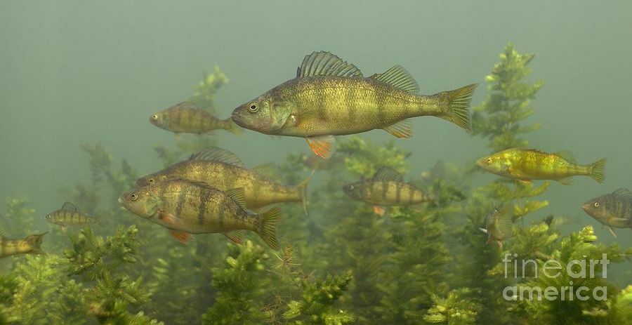
Status Updates
IDNR Coastal Management Program
Great Lakes Restoration Initiative
Calumet Conservation Compact
Lake Plain Habitat Restoration Partnership
Notes:
I could talk about each of these bullet points for 15 minutes. Suffice it to say, there are a number of new and ongoing initiatives that protect, enhance, and maintain Lake Michigan and coastal wildlife

Slide 6
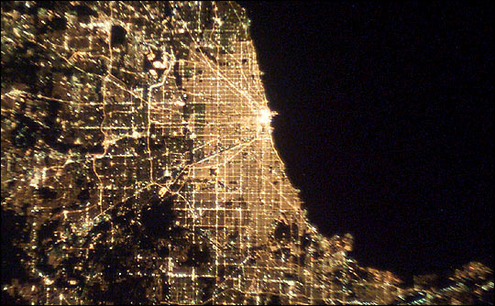
Stresses and Threats
Habitat Loss and Degradation
Fragmentation
Disturbance
Invasive Species
Pollution
Direct Anthropogenic Stresses (e.g. collisions with buildings, road mortality)

Slide 7
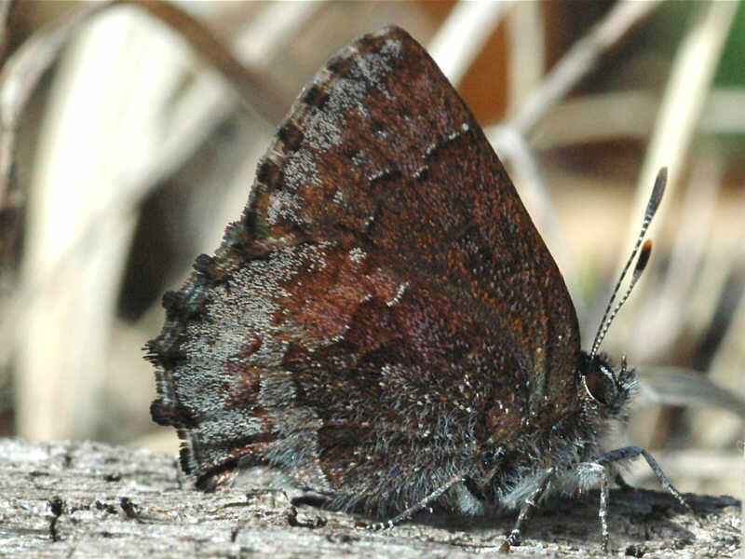
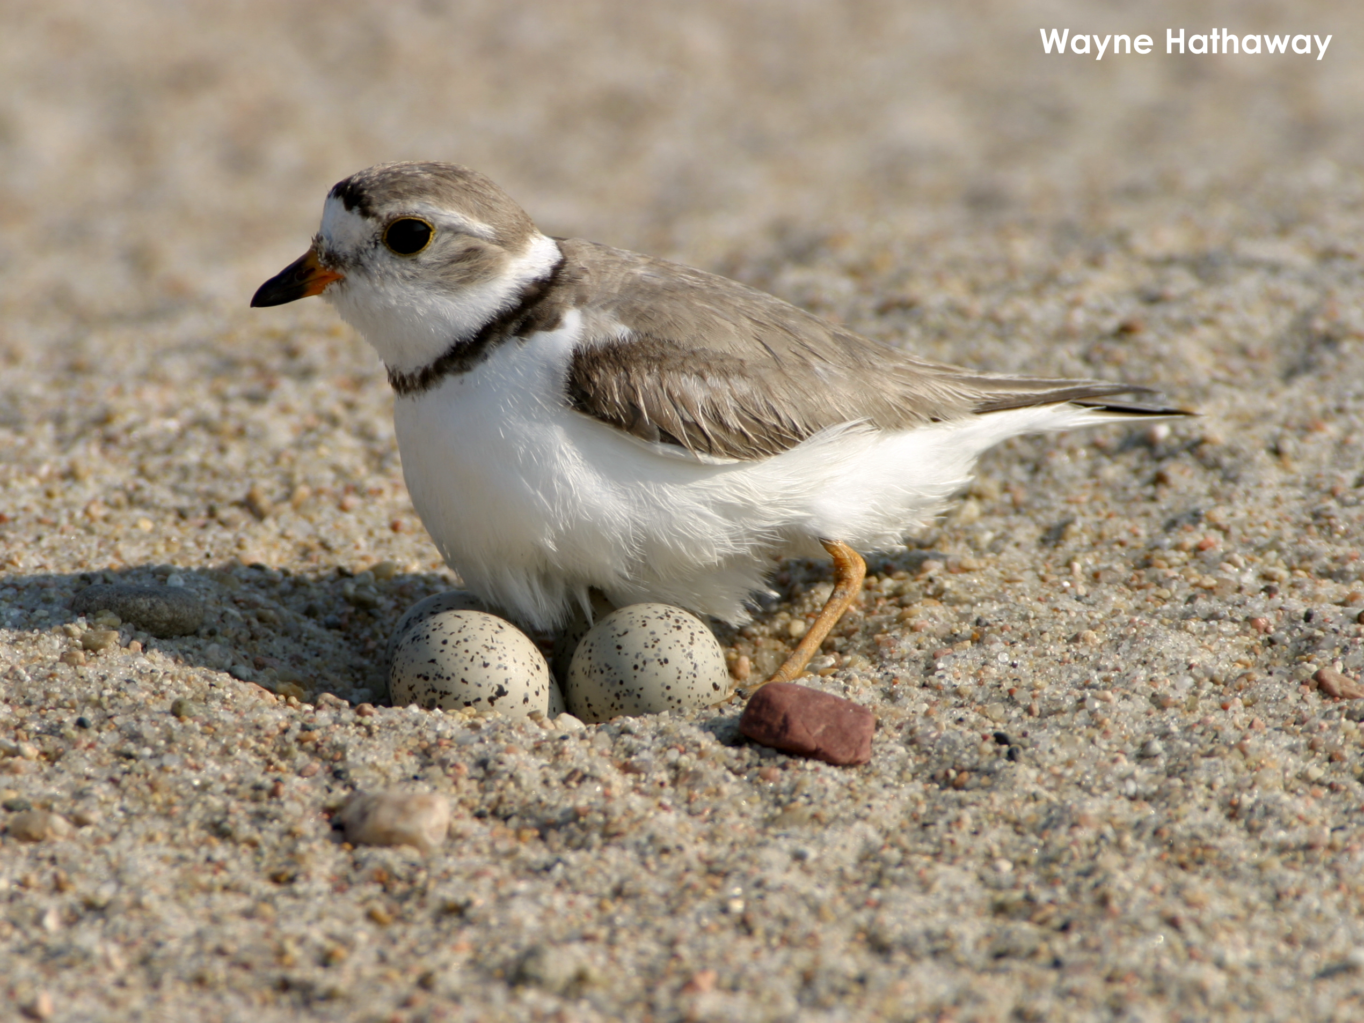
Focal Species
Piping Plover (Charadrius melodus)
Common Tern (Sterna hirundo)
Red-headed Woodpecker (Melanerpes erythrocephalus)
Sedge Wren (Cistothorus platensis)
Black-crowned Night-heron (Nycticorax nycticorax)
Hoary Elfin (Callophrys polios)
Mudpuppy (Necturus maculosus)
Blanding's Turtle (Emydoidea blandingii)
Lake Trout (Salvelinus namaycush)
Mottled Sculpin (Cottus bairdii)
Cisco (Coregonus artedi)
Banded Killifish (Fundulus diaphanus)

Slide 8
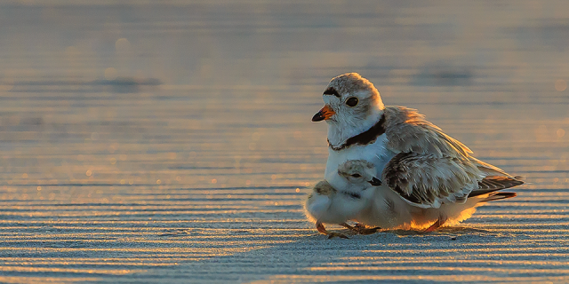
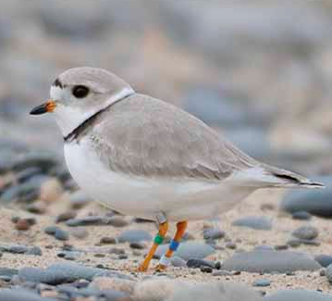
Piping Plover

Slide 9
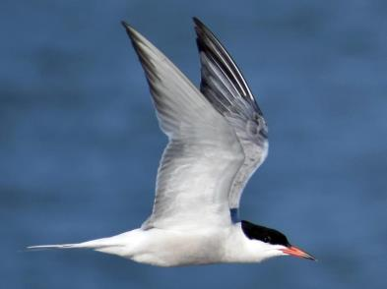
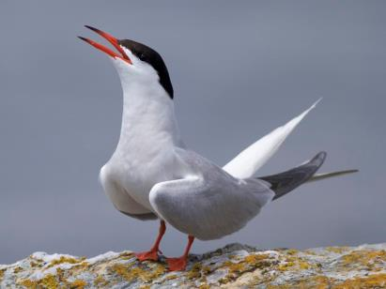
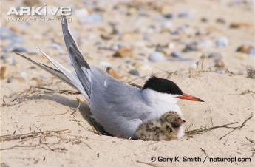
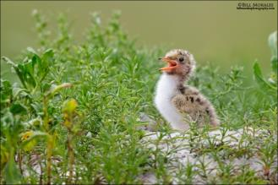
Common Tern

Slide 10
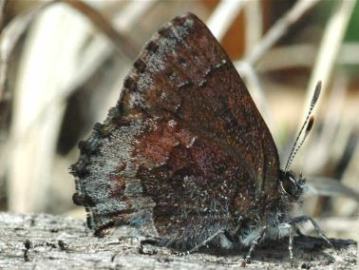
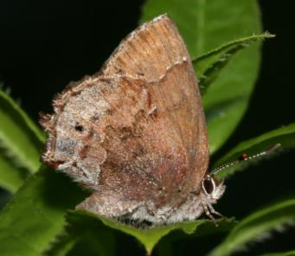
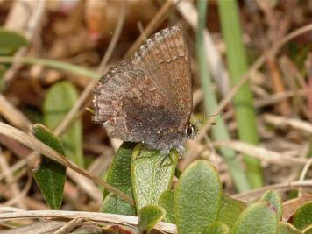
Hoary Elfin
Hoary Elfin
Similar Species-
Frosted Elfin
Note spot on hindwing and no frosting on forewing

Slide 11
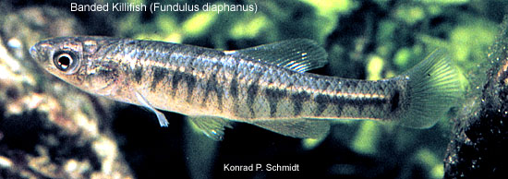
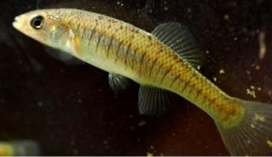
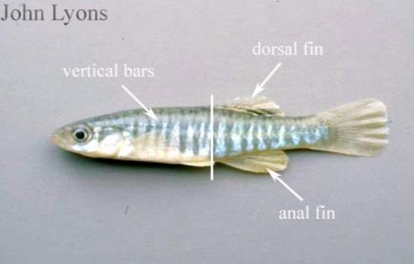
Banded Killifish

Slide 12
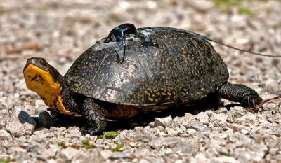
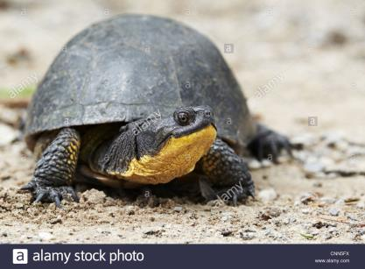
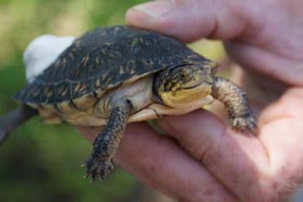
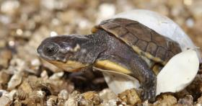
Blanding’s Turtle

Slide 13
Universal Actions
Prevent, minimize and mitigate non-point source pollution and marine debris
Promote use of native species for landscaping and gardening
Promote remediation and restoration of contaminated sites
Encourage strategies to reduce the amount of road salt
Reduce combined sewer overflows.
Preserve and protect high-quality natural areas.

Slide 14
Targeted Actions
Specific, place-based actions designed to address a particular need, stressor, or situation
Benefit focal species
Tied to anticipated outcomes and performance measures

Slide 15
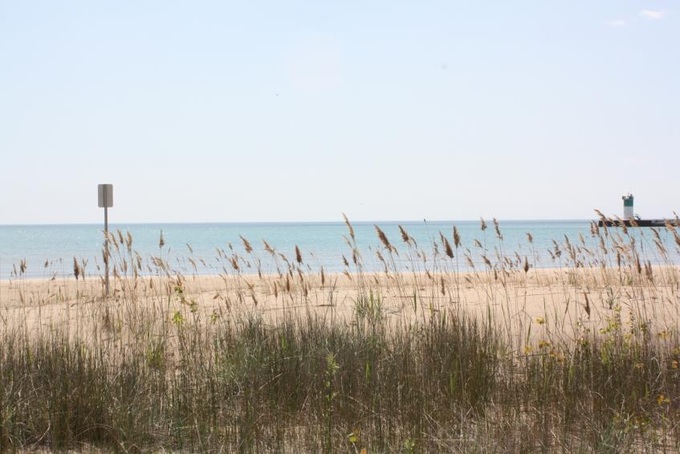
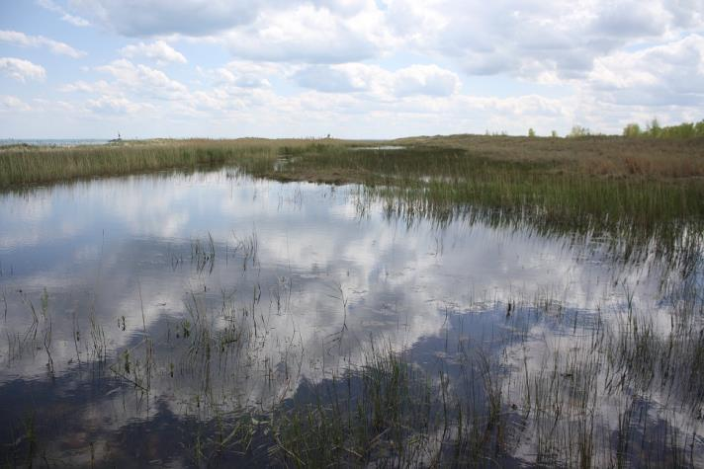
Targeted Actions Foredune, Panne, Dune, and Swale
Control invasive plants
Prevent trampling
Promote dune restoration
Education and outreach on sensitive lakeshore species
Develop a lakeshore habitat restoration and management guide for landowners

Slide 16
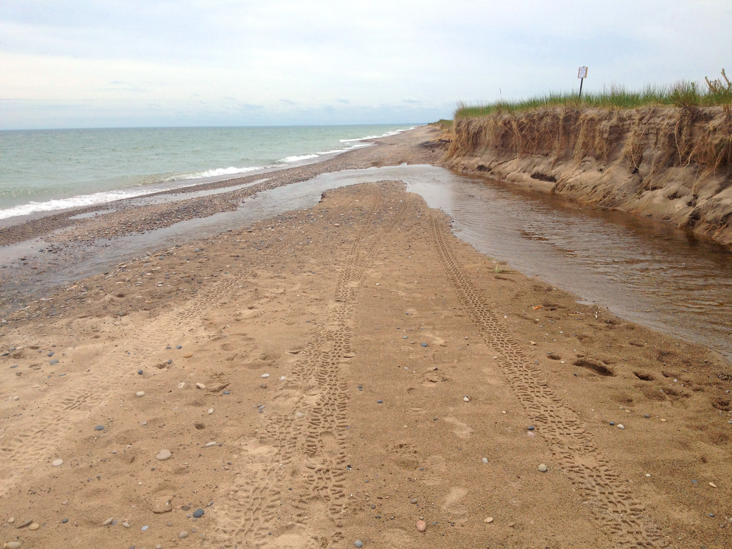
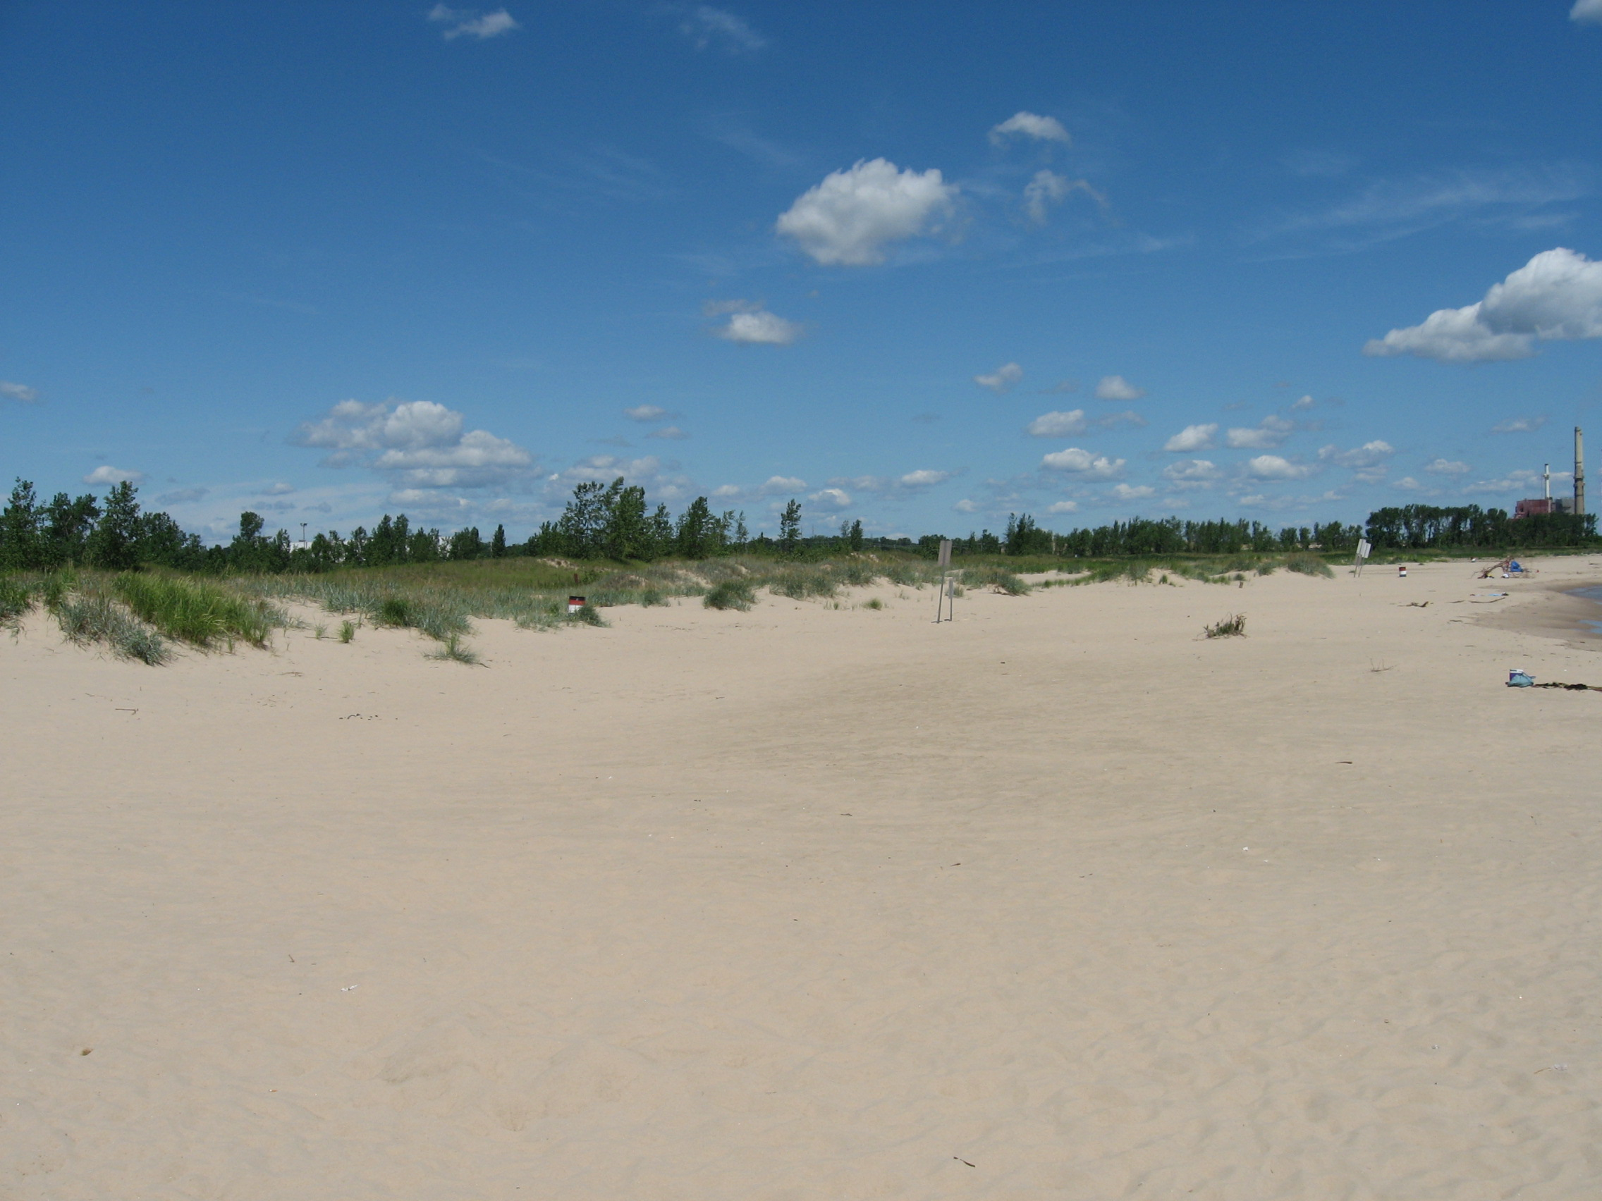
Targeted Actions Beaches
Sand nourishment to provide broader beaches for nesting plovers.
Timely predator-proof fencing installation for nesting shorebirds
Captive rearing and release of Piping Plovers.
Raise public awareness of the value of beaches as habitat
Beach cleanup and litter prevention activities.
Implementation of Total Maximum Daily Loads and best management practices
Research and reduce outbreaks of avian botulism.

Slide 17
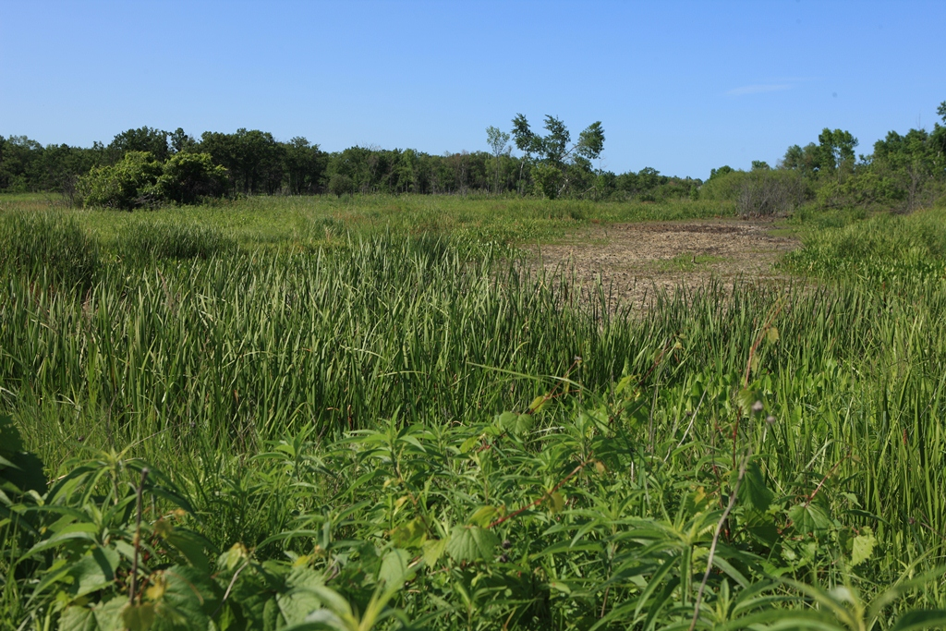
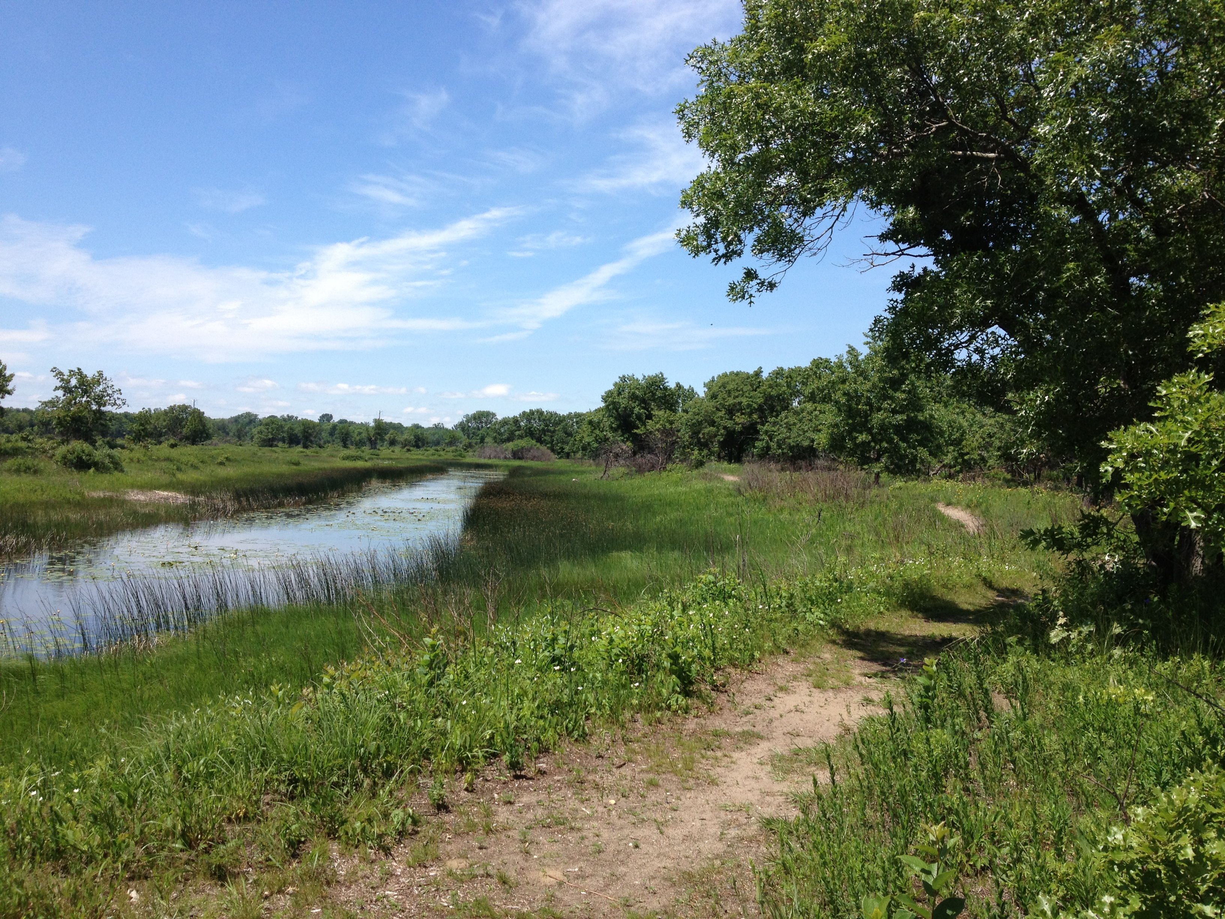
Targeted Actions Wetlands
Control invasive plants and maintain healthy native aquatic vegetation
Implement strategies to reduce wildlife road mortality
Implement strategies to increase recruitment and promote habitat connectivity for Blanding’s Turtles
Maintain and improve wetland hydrology
Ensure connectivity between wetlands and upland grasslands adjacent to wetlands to attract breeding bitterns and King Rails and provide nesting habitat for Blanding’s Turtle

Slide 18
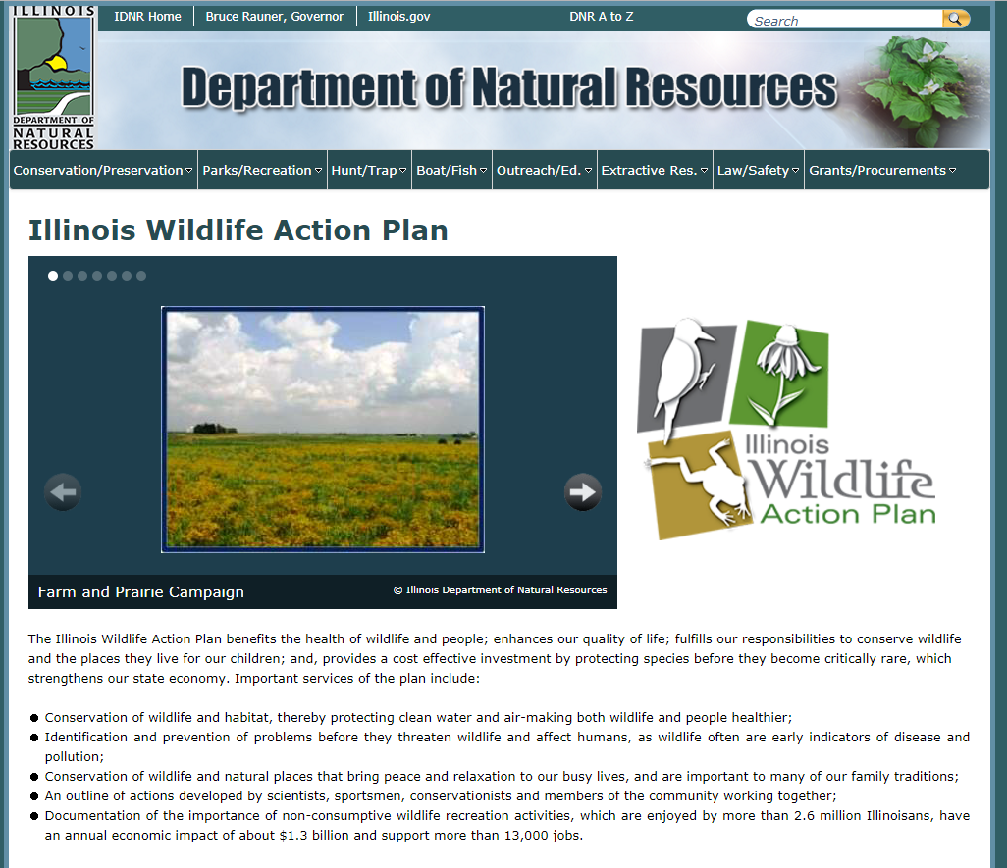
Illinois Wildlife Action Plan
Available on the web at:
https://www.dnr.illinois.gov/conservation/IWAP/Pages/default.aspx
(or just Google “Illinois Wildlife Action Plan”)

Slide 19
Wildlife Action Plan Implementation
Track work that is already happening
Work with partners to implement more on the ground projects
Monitor impacts of restoration on wildlife

Slide 20
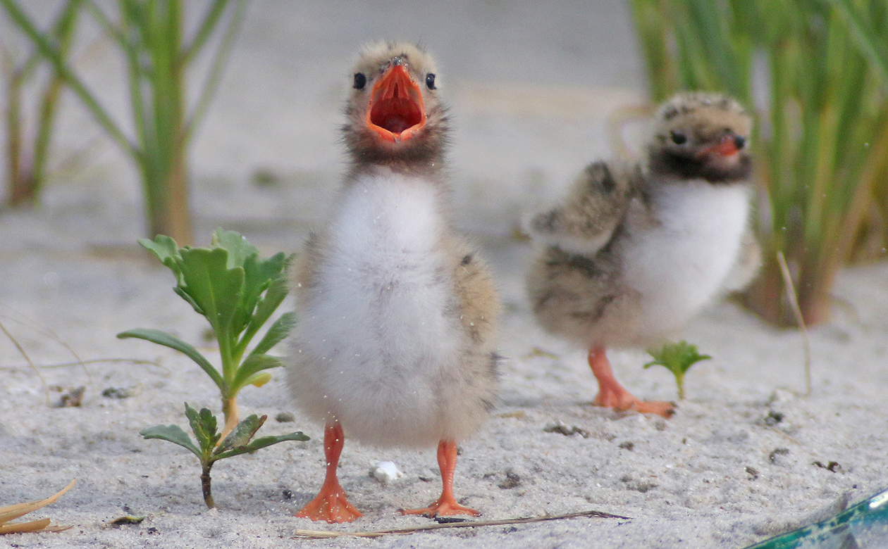
How to help:
Are you doing restoration work?
Are you tracking restoration work?
Are you monitoring wildlife?
Email me at:
Lisa.Cotner@Illinois.gov

Slide 21
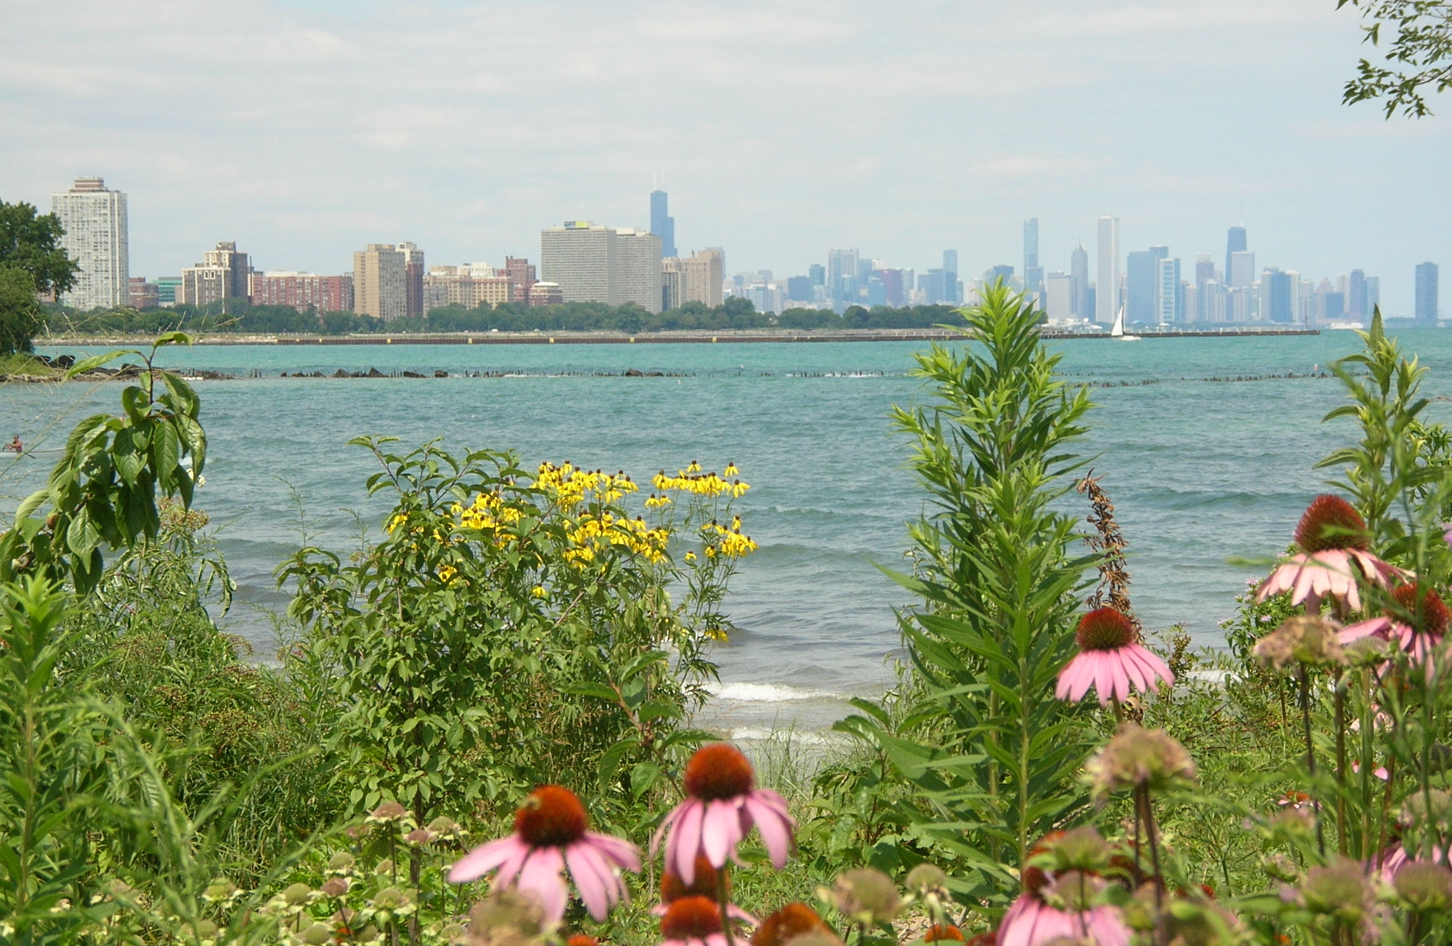
Questions?
Contact Information:
Lisa Cotner
Lisa.Cotner@illinois.gov
(312)814-6414

