Slide 1
The Total Maximum Daily Load (TMDL) Program in Illinois
Collin A. Stedman
Planning Unit
Watershed Management Section
Bureau of Water
Illinois Environmental Protection Agency

Slide 2
Illinois EPA Bureau of Water
Integrated Water Quality Report
Surface Water Monitoring Programs
Designated Uses and Water Quality Standards
305(b) Waterbody Assessments
303(d) Impaired Waters List
http://www.epa.state.il.us/water/tmdl/303d-list.html#2014

Slide 3
Water Resources of Illinois
119,244 stream miles / 17,716 assessed (15%)
318,477 lake acres/ 149,849 assessed (47%)
Lake Michigan – 64 miles shoreline/ 51 assessment units, 1,526 sq. miles open water/ 196 assessed (13%)

Slide 4
IEPA Stream Data Sources
Surface Water Section (Regional Offices)
Ambient Water Quality Monitoring Network (AWQMN)
9 x per year/ Chemical
Ambient Lake Monitoring Program (ALMP)
1 every 5 years/ Chemical and some biological
Intensive Basin Surveys, Clean Lake Program Intensives
1 every 5 years/ Biological, chemical, physical habitat
Facility Related Stream Surveys (FRSS)
Biological, chemical

Slide 5
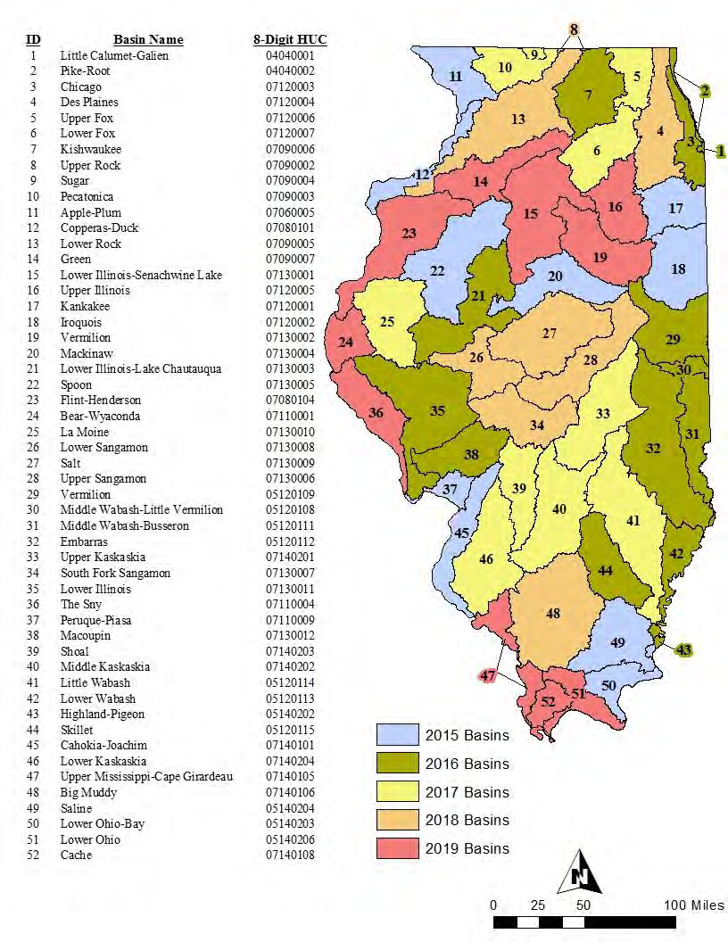
Intensive Basin Survey Monitoring Schedule 2015-2020
http://www.epa.illinois.gov/topics/water-quality/monitoring/index
http://www.epa.illinois.gov/topics/water-quality/surface-water/index

Slide 6
Section 305(b)
Federal Water Pollution Control Act of 1972, Clean Water Act of 1977 and subsequent amendments.
40 CFR section 130.
Prepare and submit a report which shall include a description of the water quality of all waters in the State.
Illinois EPA publishes this report biennially.

Slide 7
Designated Uses
Aquatic Life- Fish, invertebrates, algae
Biological, habitat and chemical data
Primary Contact- Swimming
Fecal coliform bacteria
Secondary Contact- General recreation: boating, skiing, etc.
Physical/chemical data
Public Water Supply- Condition of raw/finished water used.
Chemical data
Fish Consumption- Associated human health risks/concerns.
Fish Consumption Advisories/ Fish Tissue Analysis
Aesthetic Quality- Pleasing appearance

Slide 8
Water Quality Standards and Cause guidelines
Water Quality Standards are adopted by the Illinois Pollution Control Board
Numeric (0.05 mg/l total phosphorus (lakes))
Narrative (shall be free of excess algae)
Derived Water Quality Standards

Slide 9
Integrated Report Water Quality Report and Section 303(d) List
305(b) Water Assessments- all assessed waters and the impairments (including nonpollutants that are not in 303(d) List) (Appendix B-2 and B-3)
303(d) List- Pollutants that require TMDLs (Appendix A-1)
Maps with all waters (Appendix A-5)

Slide 10
303(d) List of Impaired Waters
Mandated by Section 303(d) of Clean Water Act
Category 5 = 303(d) List
Appendix A-1 of 2014 Integrated Report

Slide 11
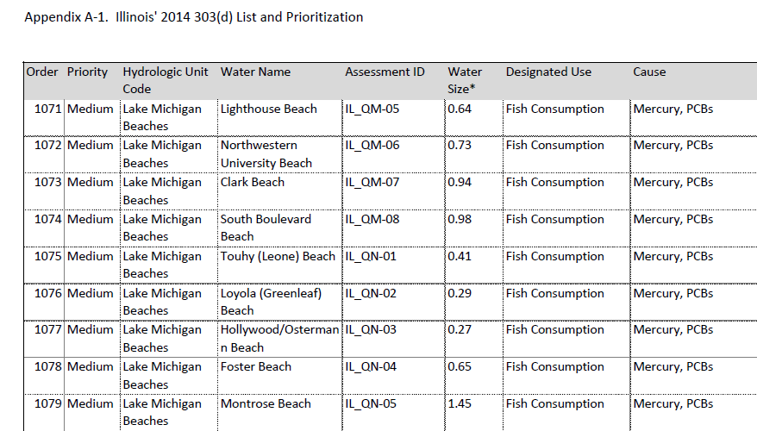
2014 303(d) Project Area List
Lake Michigan Nearshore
4 Lake Michigan Harbors
51 Lake Michigan Beaches
http://www.epa.illinois.gov/topics/water-quality/monitoring/lake-michigan/index

Slide 12
Watersheds
Waterbodies are grouped into watersheds
Based on drainage patterns and topography
A watershed is all of the area of a landscape that drains into a particular waterbody, such as a stream or a lake.
A watershed can be as small as an area that drains into a small tributary or as large as the Mississippi River Basin.
The 303(d) List is prioritized by HUC-10s

Slide 13
TMDL Process
Total Maximum Daily Load= how much of a pollutant a water body can have without exceeding the water quality standard
TMDL = WLA (wasteload allocation) + LA (load allocation) + MOS (margin of safety) + RC (reserve capacity)

Slide 14
TMDL Outcomes
Wasteload allocations for NPDES facilities
Verify meeting current permit limits (DMRs)
WLAs based on current permits or reductions if necessary
Load allocations for nonpoint sources
Reductions will require voluntary approach
Implementation plan will include recommended implementation actions
Voluntary best management practices (BMPs) and funding sources
Watershed group instrumental for local approach

Slide 15
IEPA TMDL Process
3 Stage approach- stage 1 watershed characterization, stage 2 monitoring, stage 3 load allocations/implementation
Public meetings are held in stage 1 and 3
Comments are received and responsiveness summary developed

Slide 16
Collin A. Stedman
TMDL Program
Collin.Stedman@Illinois.gov
(217)-782-3362
IEPA Address
1021 North Grand Avenue East
Springfield, IL 62794
www.epa.illinois.gov

