Slide 1

Illinois Lake Michigan (nearshore) Mercury and PCB TMDLs
Public Meeting
May 2015

Slide 2
Outline
Project study area
Overview of mercury and PCB impairments
Overview of TMDL Scoping Report
Receive comments on the Scoping Report

Slide 3
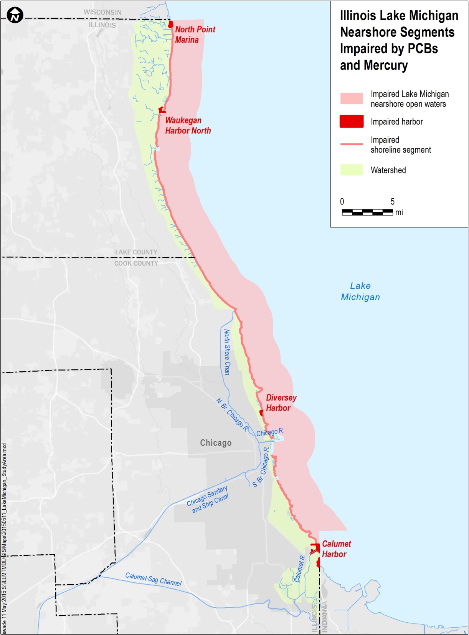
Project study area Waters to be addressed
IEPA has identified 56 Lake Michigan nearshore segments that are impaired due to PCBs and mercury.
51 beach/shoreline segments
4 harbors
1 nearshore open water segment
Notes:
The open waters of Lake Michigan means all of the waters within Lake Michigan in Illinois jurisdiction lakeward from a line drawn across the mouth of tributaries to Lake Michigan, but not including waters enclosed by constructed breakwaters (35 Ill. Adm. Code 303.443 a).
Impaired waterbody segments are shown in red and include:
51 beach/shoreline segments totaling ~63.5 miles
4 harbors with a total area of ~2.5 square miles
1 nearshore open water segment (5 km offshore), which is ~180 square miles
The watershed is shown in green and includes portions of Lake County and Cook County.
You’ll see that the watershed hugs the shoreline, and is much smaller than you might expect. It’s ~100 square miles in size.
This is because many of the rivers shown on this map flow to the Mississippi River, instead of to Lake Michigan. As a result, they are outside of the project study area.

Slide 4
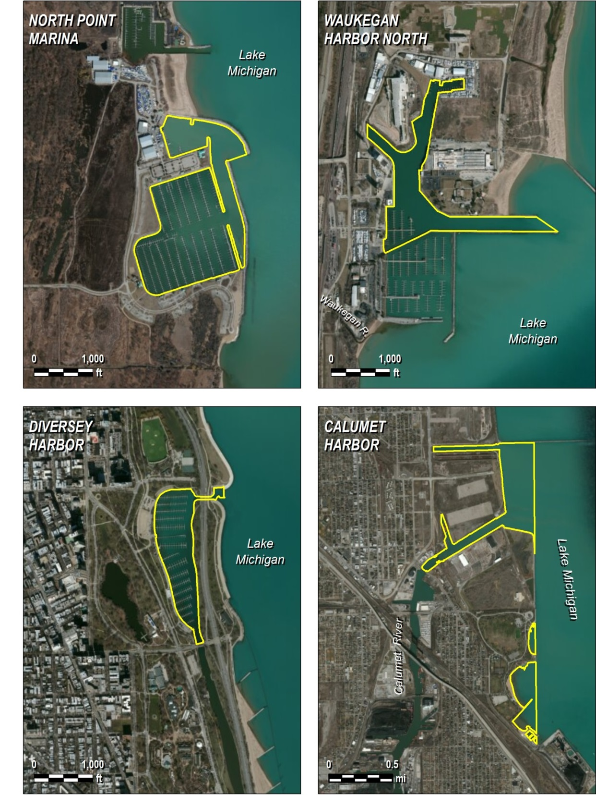
Study Area Harbors
North Point Marina
Waukegan Harbor North
Diversey Harbor
Calumet Harbor
Notes:
Harbors:
North Point Marina (0.12 mi²)
Waukegan Harbor North (0.07 mi²)
Past remediation activities at the Outboard Marine Corporation Site. Over 150,000 cubic yards of PCB-contaminated sediment have been removed.
Diversey Harbor (0.05 mi²)
Calumet Harbor (2.4 mi²)
Deep draft commercial harbor

Slide 5
Outline
Project study area
Overview of mercury and PCB impairments
Overview of TMDL Scoping Report
Receive comments on the Scoping Report

Slide 6

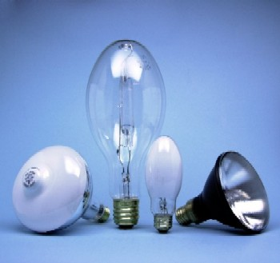
Mercury Impairments What is Mercury?
Naturally occurring elemental chemical
Chemical symbol Hg
Heavy metal
Many industrial uses
Batteries
Paint (historical)
Lighting
Switches
Thermometers
Dental

Slide 7
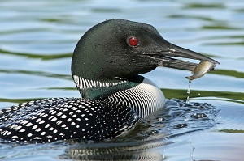
Mercury Impairments Environmental Effects
Causes adverse health effects
Impaired neurological development
Primary concern is methyl-mercury in fish
Methyl mercury concentrations in water can bioaccumulate 1,000,000 times in fish
Consumption of contaminated fish is a significant human health and wildlife concern
Notes:
Health effects: impairment of the peripheral vision; disturbances in sensations ("pins and needles" feelings, usually in the hands, feet, and around the mouth); lack of coordination of movements; impairment of speech, hearing, walking; and muscle weakness
Methylmercury (MeHg) – one form of mercury
Methylmercury is easily adsorbed into living tissue of aquatic organisms and is not easily eliminated.

Slide 8
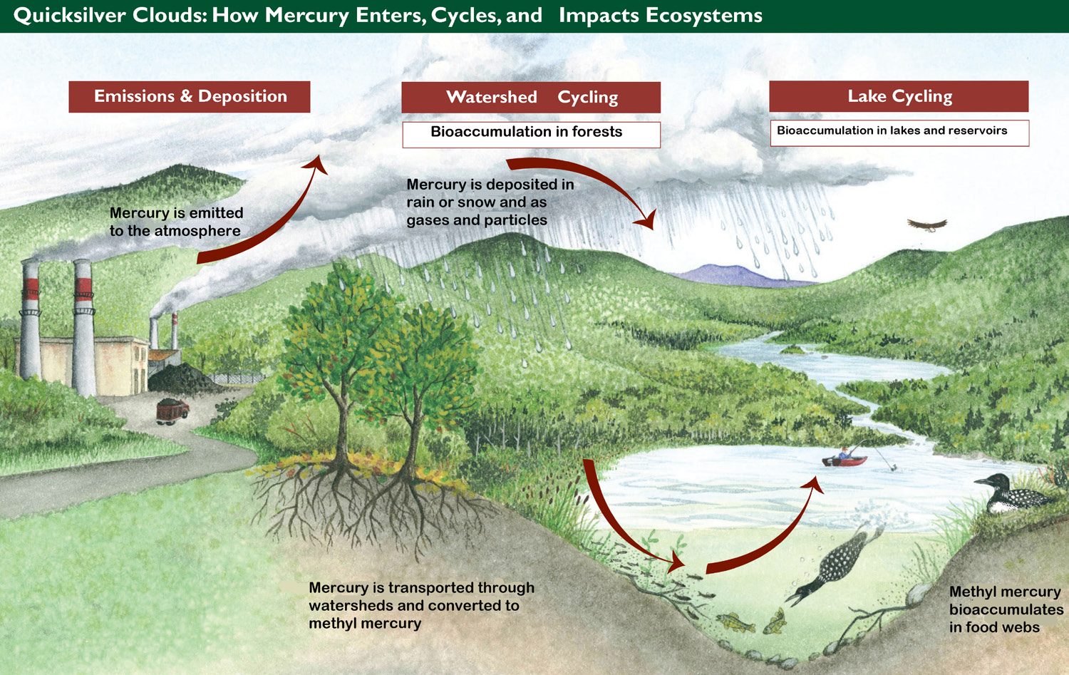
Mercury Impairments Caused Primarily by Atmospheric Deposition
Driscoll, C.T., D. Evers, K.F. Lambert, N. Kamman, T. Holsen, Y-J. Han, C. Chen, W. Goodale, T. Butler, T. Clair, and R. Munson. Mercury Matters: Linking Mercury Science with Public Policy in the Northeastern United States. Hubbard Brook Research Foundation. 2007. Science Links Publication. Vol. 1, no. 3.
Notes:
Natural (volcanos) and human-caused sources.
Main source is air emissions from power generation and other industrial and waste disposal activities.
During it’s movement among the atmosphere, land and water, mercury undergoes a series of complex chemical transformations. One product is organic form – methylmercury.
Methylmercury is easily adsorbed into living tissue of aquatic organisms and is not easily eliminated.

Slide 9

Mercury Impairments to Designated Uses
Aquatic Life Use Impairment
Based on the most recent 3 years of water quality data.
At least two exceedances of the acute numeric standard within the most current 3-year period.
>10% of samples are less than or equal to the chronic standard, and the mean is less than or equal to the chronic standard.
Fish Consumption Use Impairment
Waterbody-specific fish-tissue data collected since 1985.
Fish consumption advisories issued by Illinois Fish Contaminant Monitoring Program
Notes:
The aquatic life use listing of Waukegan Harbor North is from the 2008 303(d) list.

Slide 10
Mercury Impairments: Average Concentration by Fish Species
Species | Count of Samples | Average Concentration (mg/kg)
Largemouth bass | 3 | 0.280
Smallmouth bass | 7 | 0.110
Rock bass | 9 | 0.102
White sucker | 4 | 0.053
Sunfish | 5 | 0.033
Black bullhead | 2 | 0.055
Rainbow trout | 2 | 0.064
Brown trout | 1 | 0.103
Red values exceed fish consumption target of 0.06 mg/kg
Notes:
Fish data from 1999-present that were collected within the study area show that mercury contamination is widespread among fish species and waterbodies.

Slide 11
PCB Impairments What are PCBs?
PCB = polychlorinated biphenyl
synthetic, chlorinated organic chemicals
produced mainly for their insulating capabilities and chemical stability
Banned from production in 1979
Cause a variety of health effects
impacts to the nervous, immune, reproductive, and endocrine systems
cancer

Slide 12
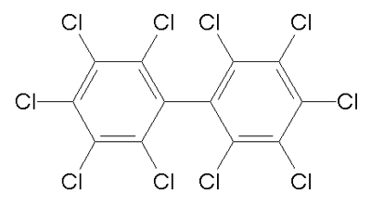
PCB Impairments What are PCBs?
Chemical nature of PCBs makes them an environmental issue, even though their production has long been banned
Chemical stability makes them long-lasting in the environment
Strong tendency to accumulate in fish tissue

Slide 13
PCB Sources
PCBs are a man-made compound, with no natural sources
PCBs enter Lake Michigan waters primarily from the atmosphere
Sources to the atmosphere consist primarily of remnants from past PCB uses
Capacitors, transformers, and other electrical equipment
Often accumulated in landfills, scrap yards
Notes:
While PCBs can come from many sources, the focus of this TMDL is on atmospheric sources.
Waukegan Harbor is a significant source of historical PCB contamination. Contaminated sediments have been dredged in 1992/93 and again in 2012/13 and it presumably is no longer a significant source.

Slide 14

PCB Impairments to Designated Uses
Fish Consumption Use Impairment
Waterbody-specific fish-tissue data
A waterbody-specific, “restricted consumption” or “no consumption” fish consumption advisory is in effect
Notes:
There is no aquatic life use assessment for PCBs for Lake Michigan basin.
The aquatic life use listing of Waukegan Harbor North is from the 2008 303(d) list.
Restricted consumption = limits on the number of meals or size of meals consumed per unit time.

Slide 15
PCB Impairments: Average Concentration by Fish Species
Species | Count of Samples | Average Concentration (mg/kg)
Carp | 52 | 4.329
Lake trout | 30 | 0.811
Black bullhead | 3 | 1.027
Rock Bass | 10 | 0.276
Sunfish | 7 | 0.189
Largemouth Bass | 4 | 0.225
Bloater | 7 | 0.270
White sucker | 6 | 0.237
Species | Count of Samples | Average Concentration (mg/kg)
Smallmouth bass | 7 | 0.172
Pumpkinseed sunfish | 3 | 0.183
Alewife | 6 | 0.187
Round goby | 3 | 0.137
Yellow perch | 22 | 0.092
Brown Trout | 1 | 0.659
Rainbow trout | 2 | 0.152
Rainbow smelt | 1 | 0.100
Red values exceed target of 0.06 mg/kg
Notes:
PCB contamination is widespread among species and water bodies.
All species exceed the target.

Slide 16
Objectives
Project study area
Overview of mercury and PCB impairments
Overview of TMDL Scoping Report
Receive comments on the Scoping Report

Slide 17

TMDL Scoping Report
Determine numeric TMDL target for mercury and PCBs
Select a target fish species
Recommend approach for defining the relationship between pollutant load and concentration in water/fish
Develop a conceptual model and assess data gaps
Notes:
In Early May released a scoping report for the TMDL Approach. Final Loading Capacity Calculation, Waste Load and Load Allocations have been under discussion taking into account comments from the May through June comment period for the TMDL approach document.

Slide 18
Numeric Targets
Define acceptable water quality
How much mercury and PCBs can we have and not impair the designated uses?
TMDL targets must be expressed at a level to demonstrate attainment of State Water Quality Standards (WQS)

Slide 19


Mercury Water Quality Standards
Numeric mercury water quality criteria
1.3 ng/L for the Wildlife Value
3.1 ng/L for Human Health Protection
1,700 ng/L for Aquatic Acute Toxicity
910 ng/L for Aquatic Chronic Toxicity
0.06 mg/kg for Fish Consumption
Based on 0.10 ug/kg/day Health Protection Value for fish consumption for sensitive populations

Slide 20
PCB Water Quality Standards
Numeric water quality criteria for PCBs
Wildlife Value of 0.12 ng/L
Human Cancer Value of 0.026 ng/L
Fish consumption advisory triggered
0.06 mg/kg fish tissue
Based on the health protection value of 0.05 ug/kg/day
Notes:
"Standard" means a definite numerical value or narrative statement (i.e. statements of unacceptable conditions).
When multiple different water quality standards exist, numeric target in TMDLs are set to protect the most restrictive of the WQS.

Slide 21
TMDL Targets
Health Protection Value for fish consumption for sensitive populations used to derive TMDL target
0.06 mg/kg for PCBs
0.06 mg/kg for mercury
TMDL target will also need to demonstrate that compliance with the fish tissue TMDL target will also meet the most protective water quality targets.
0.026 ng/l for PCBs
1.3 ng/l for mercury

Slide 22
Target Fish Selection - Characteristics
Many species sampled to assess fish consumption impairment; however, more efficient to evaluate one species to determine reductions needed.
Selected species should possess the following:
Concentrations near the upper bound for all species
Consumable by humans
Sampled abundantly enough so TMDL is not overly influenced by potential sampling variability
Notes:
Mercury data are from 8 species
PCB data are from 18 species
Ideally, we would also want the selected species to “Allow for application of TMDL approach that considers geographic, chemical loading and temporal variability”
Available data, however, are inadequate to allow for this.

Slide 23
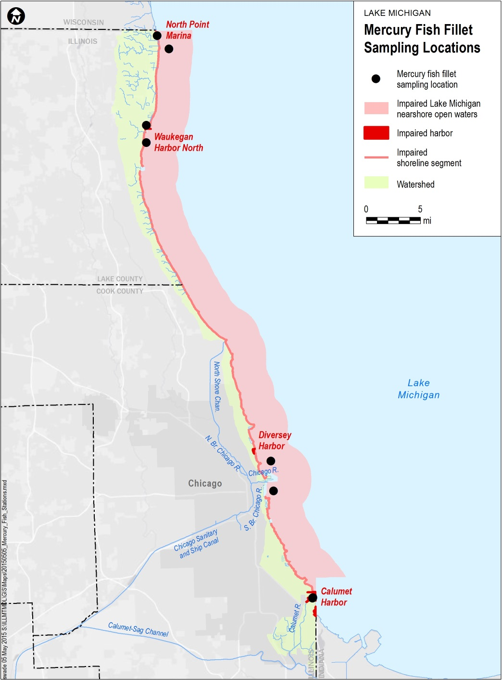
Target Fish Selection – Available Mercury Data (fish fillets)
Fish | Nearshore open water/ shoreline | Calumet Harbor | North Point Marina | Waukegan Harbor | Total Count
Largemouth bass |  |  | 3 |  | 3
Smallmouth bass |  | 5 | 2 |  | 7
Brown trout | 1 |  |  |  | 1
Rock bass |  | 1 | 4 | 4 | 9
Rainbow trout | 2 |  |  |  | 2
Black bullhead |  |  |  | 2 | 2
White sucker |  |  | 2 | 2 | 4
Sunfish |  |  | 3 | 2 | 5
Grand Total | 3 | 6 | 14 | 10 | 33
Notes:
33 mercury samples
8 species

Slide 24
Target Fish Recommendations-Mercury
Largemouth Bass
Most highly contaminated, but only 3 samples exist
Spatial coverage by largemouth bass (and all species) is inadequate to support segment-specific TMDL reduction calculations
TMDL calculations will require pooling of fish data across sites
Fish | Nearshore open water/ shoreline | Calumet Harbor | North Point Marina | Waukegan Harbor | Total Count | Average Concentration (mg/kg)
Largemouth bass |  |  | 3 |  | 3 | 0.2800
Smallmouth bass |  | 5 | 2 |  | 7 | 0.1096
Notes:
Mercury data are from 8 species
No more than 2 samples available for any species describing mercury concentration in the nearshore zone
Could also pool smallmouth bass (7 samples from Calumet Harbor and NP Marina) with largemouth bass to create a larger dataset. Smallmouth bass have second highest concentrations.

Slide 25
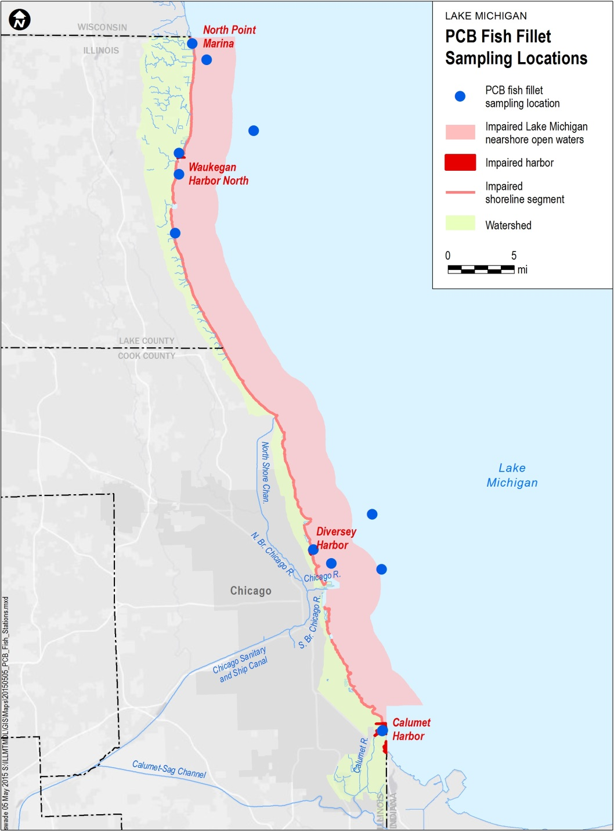
Target Fish Selection – Available PCB Data (fish fillets)
Fish | Nearshore open water/ shoreline | Calumet Harbor | Diversey Harbor | North Point Marina | Waukegan Harbor | Total
Alewife | 6 |  |  |  |  | 6
Black bullhead |  |  |  |  | 3 | 3
Bloater chub | 7 |  |  |  |  | 7
Brown trout | 1 |  |  |  |  | 1
Carp |  |  |  | 12 | 40 | 52
Lake trout | 30 |  |  |  |  | 30
Largemouth bass |  |  |  | 3 | 1 | 4
Pumpkinseed sunfish |  |  | 1 |  | 2 | 3
Rainbow smelt | 1 |  |  |  |  | 1
Rainbow trout | 2 |  |  |  |  | 2
Rock bass |  | 1 |  | 4 | 5 | 10
Round goby |  | 1 |  | 2 |  | 3
Smallmouth bass |  | 5 |  | 2 |  | 7
Sunfish |  |  |  | 4 | 3 | 7
White sucker |  |  |  | 2 | 4 | 6
Yellow perch | 21 |  |  |  | 1 | 22
Grand Total | 68 | 7 | 1 | 29 | 59 | 164
Notes:
164 PCB samples
16 species

Slide 26
Target Fish Selection – Available PCB Data (fish fillets)

Slide 27
Target Fish Recommendations-PCBs
Carp
Most highly contaminated and widely sampled
No samples from Diversey Harbor, Calumet Harbor or the Nearshore open water/shoreline
May reflect historic conditions
Rock bass and lake trout also candidate species
Fish | Nearshore open water/ shoreline | Calumet Harbor | North Point Marina | Waukegan Harbor | Total Count | Average Concentration (mg/kg)
Carp |  |  | 12 | 40 | 52 | 4.329
Rock Bass |  | 1 | 4 | 5 | 10 | 0.276
Lake Trout | 30 |  |  |  | 30 | 0.811
Notes:
PCB data are from 18 species

Slide 28
Basic Steps in TMDL Development
Watershed characterization
Define area of concern
Assess extent of contamination
Specify TMDL “Target”
Pollutant concentration that maintains compliance with designated uses
Define relationship between pollutant load and concentration (current)
Focus of the Scoping Report
Define pollutant load that meets target

Slide 29
TMDL Development Relating Loads to Water Quality
Loads
Concentration
Model
TMDLs require an assessment of the relationship between pollutant loads and resulting concentration in the water and/or fish
Typically conducted using mathematical models

Slide 30
TMDL Development Relating Loads to Water Quality
Loads
Concentration
Model
Compliance with water quality objectives?
The model is used to determine the maximum load that will result in compliance with water quality objectives

Slide 31
TMDL Development Relating Loads to Water Quality
Loads
Concentration
Model
No
Reduce loads
Compliance with water quality objectives?

Slide 32
TMDL Development Relating Loads to Water Quality
Loads
Concentration
Model
No
Reduce loads
Compliance with water quality objectives?
Yes
Done

Slide 33
Relating Loads to Water Quality Selecting a Model
Many different types of models exist
Selection of appropriate model requires consideration of
Temporal scale
Spatial scale
Loading sources considered
Pollutant forms
Environmental compartments considered
Fate & transport processes considered
Notes:
Whe we compared models for the job, these are some of the capilities that were reflected in different ways in the models we considered.

Slide 34
Relating Loads to Water Quality Selecting a Model
Many different types of models exist
Selection of appropriate model requires consideration of
Temporal scale
Does the model consider how concentrations change over time, or does it only answer what will happen in the long run?

Slide 35
Relating Loads to Water Quality Selecting a Model
Many different types of models exist
Selection of appropriate model requires consideration of
Spatial scale
Does the model treat the entire study area as one lumped entity, or does it handle each impaired segment individually?

Slide 36
Relating Loads to Water Quality Selecting a Model
Many different types of models exist
Selection of appropriate model requires consideration of
Loading sources considered
What are the potential sources of mercury and PCBs to these waters?
Notes:
Pathways between source and the transport of the pollutant to waters of concern.

Slide 37
Relating Loads to Water Quality Selecting a Model
Many different types of models exist
Selection of appropriate model requires consideration of
Pollutant forms
Do we consider individual chemical forms or just total pollutant concentration?

Slide 38
TMDL Development Relating Loads to Water Quality
Many different types of models exist
Selection of appropriate model requires consideration of
Environmental compartments considered
Are we predicting concentrations in just the water column, and/or in fish, and/or in bottom sediments?

Slide 39
Relating Loads to Water Quality Selecting a Model
Many different types of models exist
Selection of appropriate model requires consideration of
Fate & transport processes considered
How does the model describe what happens to the pollutant once it enters the water body?

Slide 40
Relating Loads to Water Quality Selecting a Model
Models of toxic contamination of water and fish can be divided into three frameworks
Level One: Simple proportionality approaches
Level Two: Steady state mass balance approaches
Level Three: Time-variable model of pollutant forms in water column and sediments

Slide 41
Selecting a Model 1: Simple Proportionality Approaches
Environmental concentration assumed proportional to current loading rate
Key features of level one approach
Unable to describe how pollutant concentrations will change over time
Considers entire study area as one lumped area
Assumes that the load-response relationship for each source is identical
Only addressed total pollutant concentrations.
Can consider all environmental compartments: water column, sediments, and biota.
Do not explicitly describe fate and transport processes

Slide 42
Selecting a Model 2: Steady State Mass Balance Approach
Key features of level two approach
Unable to describe how pollutant concentrations will change over time
Capable of describing how concentrations change over space
Can consider different load-response relationships for different sources
Can consider different pollutant forms
Can consider all environmental compartments: water column, sediments, and biota
Can explicitly describe fate and transport processes

Slide 43
Selecting a Model 3: Time Variable Mass Balance Approach
Key features of level three approach
Can consider how pollutant concentrations will change over time
Capable of describing how concentrations change over space
Can consider different load-response relationships for different sources
Can consider different pollutant forms
Can consider all environmental compartments: water column, sediments, and biota
Can explicitly describe fate and transport processes

Slide 44
Selecting a Model How Do We Choose Among the Options?
Why not just pick the model that has the most features?
More complex models need more data to support them
Model selection needs to balance:
The management questions that need to be answered
The resources available to support the model
Resources = data, time

Slide 45
Selecting a Model Data Gap Assessment
Conducted because model selection needs to consider how much data is available
Review available data, to define what we know (and don’t know)

Slide 46
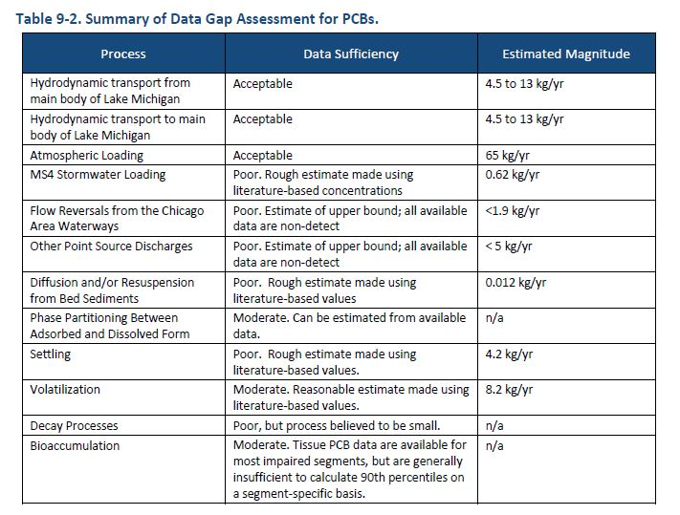
Selecting a Model Data Gap Assessment

Slide 47
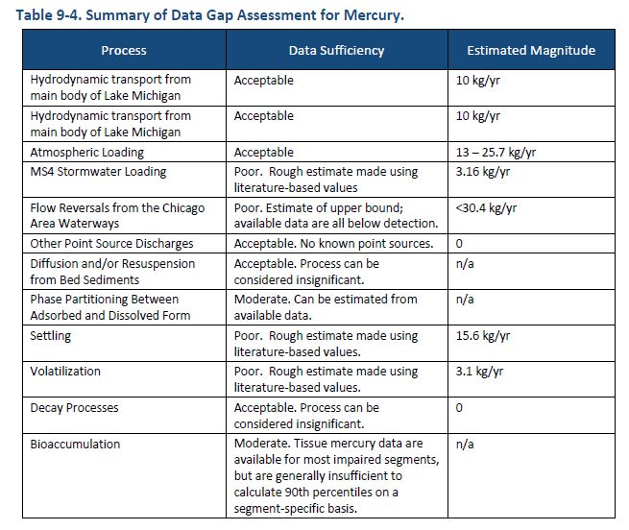
Selecting a Model Data Gap Assessment

Slide 48
Selecting a Model Data Gap Assessment
What we know
Transport of mercury and PCBs into the nearshore from the main body of Lake Michigan is a dominant source
Atmospheric loading of mercury and PCBs is a dominant source to the main lake and nearshore
Other loading sources (stormwater, treatment plants, flow reversals from the Chicago Area Waterways) are relatively small sources

Slide 49
Selecting a Model Data Gap Assessment
What we don’t know
Exactly how small the “other loading sources” are
How PCB and mercury concentrations in fish vary over time or across the impaired segments
The magnitude of specific pollutant fate processes

Slide 50
Selecting a Model Conclusions
Not nearly enough data exist to apply Level 3 approach
Would require years of additional data collection
Not enough data exist to apply Level 2 approach
Could theoretically be applied by making assumptions regarding the missing data
Sufficient data exist to apply Level 1 approach

Slide 51
Selecting a Model Conclusions
Model selection needs to balance the management questions that need to be answered with the time and data available
Decision boils down to:
Can we get a sufficiently accurate result from a Level One approach now?
or
Do we wait until additional data are collected in order to apply a more rigorous approach?

Slide 52
Selecting a Model Conclusions
Decision made easier by the nature of the problem
The dominant loads that need to be controlled will take a long time to control
The level of reduction required to achieve TMDL targets will be substantial
Final decision: Why wait for new data to make decisions that can be made now?
Level One proportionality approach recommended

Slide 53
What’s Next?
Respond to comments/input received on the Scoping Report
Final selection of TMDL modeling approach
Refine PCB and mercury loads
Apply TMDL models
Develop TMDL
Public meeting to present draft TMDLs

Slide 54
Discussion
Study area is impaired due to mercury and PCBs
Significant reductions needed for mercury and PCBs
Many types of models exist
Model selection needs to balance management questions with the available time and data
Level one proportionality approach recommended for mercury and PCB TMDLs

Slide 55
Who to Contact?
Penelope Moskus, LimnoTech
pmoskus@limno.com
734-332-1200
Collin Stedman, Illinois EPA
collin.stedman@illinois.gov
217-782-3362

